Slide 1

The One with the Data Science Analysis

Slide 2
Introduction
Looking to Gain Insight on:
Important themes
Character Evolution
Character Importance
Episode Similarities

Slide 3

Methodology
Data
Friends Transcripts
Models
NLP and Topic Modeling
Clustering and PCA
Applications
Cosine Similarity Recommendations

Slide 4
Topics
Topics
Relationships
Babies
Weddings
Family/Parents
Parties
Work
Holidays
Games

Slide 5
Topics Clusters
Topics
Relationships
Babies
Weddings
Family/Parents
Parties
Work
Holidays
Games
Clusters
Relationships (109)
Work (34)
Babies (25)
Games (22)
Weddings (20)
Parties (17)
Holidays (7)

Slide 6
Topics Clusters
Topics
Relationships
Babies
Weddings
Family/Parents
Parties
Work
Holidays
Games
Clusters
Relationships (109)
Work (34)
Babies (25)
Games (22)
Weddings (20)
Parties (17)
Holidays (7)

Slide 7

PCA Cluster Visualization

Slide 8
Clusters BY Season
BABIES
SHOW
SHOW
SHOW
MARRIAGE
SHOW
WORK
SHOW
PARTIES
GAMES
SHOW
RELATION-SHIPS
SHOW
SHOW
SHOW
SHOW
ONE
TWO
THREE
FOUR
FIVE
SIX
SEVEN
EIGHT
NINE
TEN

Slide 9
Monica – The most similar to the overall themes
BABIES
Monica
Monica
Monica
MARRIAGE
Monica
WORK
PARTIES
GAMES
Monica
RELATION-SHIPS
Monica
Monica
Monica
Monica
Monica
ONE
TWO
THREE
FOUR
FIVE
SIX
SEVEN
EIGHT
NINE
TEN

Slide 10
Rachel – very Similar to Monica (and the show)
BABIES
Rachel
Rachel
MARRIAGE
WORK
PARTIES
Rachel
GAMES
Rachel
RELATION-SHIPS
Rachel
Rachel
Rachel
Rachel
Rachel
Rachel
ONE
TWO
THREE
FOUR
FIVE
SIX
SEVEN
EIGHT
NINE
TEN

Slide 11
Phoebe – life events Least important in show
BABIES
Phoebe
Phoebe
MARRIAGE
Phoebe
WORK
PARTIES
GAMES
RELATION-SHIPS
Phoebe
Phoebe
Phoebe
Phoebe
Phoebe
Phoebe
Phoebe
ONE
TWO
THREE
FOUR
FIVE
SIX
SEVEN
EIGHT
NINE
TEN

Slide 12
Chandler – very similar to the show (and Monica)
BABIES
Chandler
MARRIAGE
Chandler
WORK
Chandler
Chandler
PARTIES
GAMES
Chandler
RELATION-SHIPS
Chandler
Chandler
Chandler
Chandler
Chandler
ONE
TWO
THREE
FOUR
FIVE
SIX
SEVEN
EIGHT
NINE
TEN

Slide 13
Ross – Less Focused on the Baby than Rachel
BABIES
Ross
Ross
MARRIAGE
WORK
PARTIES
GAMES
RELATION-SHIPS
Ross
Ross
Ross
Ross
Ross
Ross
Ross
Ross
ONE
TWO
THREE
FOUR
FIVE
SIX
SEVEN
EIGHT
NINE
TEN

Slide 14
Joey – Work is a large part of his Character
BABIES
Joey
MARRIAGE
Joey
WORK
Joey
Joey
Joey
Joey
PARTIES
GAMES
Joey
RELATION-SHIPS
Joey
Joey
Joey
ONE
TWO
THREE
FOUR
FIVE
SIX
SEVEN
EIGHT
NINE
TEN

Slide 15
Favorite Episodes
My Favorite Episode:
The One With All the Kissing
Second Favorite Episode:
The One Where Everybody Finds Out

Slide 16
Favorite Episodes: Recommendations
My Favorite Episode:
The One With All the Kissing
Top 3 Recommendations:
The One After Ross Says Rachel
The One with the Vows
The One with all the Cheesecake
Second Favorite Episode:
The One Where Everybody Finds Out
Top 3 Recommendations:
The One with the East German Laundry Detergent
The One Where Ross Finds Out
The One with the Proposal

Slide 17
The Future
Improve Recommender
Dig deeper into each character by episode
Use supervised learning techniques to make predictions

Slide 18
Questions?

Slide 19
Appendix
Top words in topics
Inertia graph
Two Dimensional PCA Clusters
Word Clouds

Slide 20
Topics
Topic 0: guy, date, night, woman, someone, phone, friend, love, wait, honey
Topic 1: baby, babies, baby baby, father, hospital, push, sex, room, honey, name
Topic 2: wedding, dress, parents, bride, picture, toast, money, night, love, groom
Topic 3: mom, dad, parents, mother, mom dad, guy, father, dad dad, school, day
Topic 4: party, birthday, bachelor, bachelor party, stripper, cake, book, parties, number, thanks
Topic 5: job, house, money, audition, office, guy, interview, joke, name, part
Topic 6: christmas, presents, santa, year, merry, hanukkaah, holiday, cookies, boxes, tree
Topic 7: game, tickets, knicks, play, money, poker, ticket, cups, game game, card

Slide 21
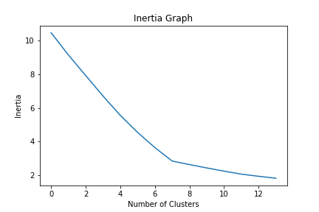
Inertia Graph

Slide 22
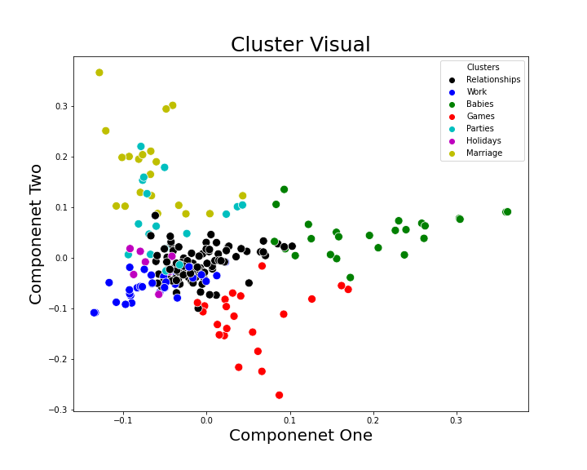
Results - Clusters

Slide 23
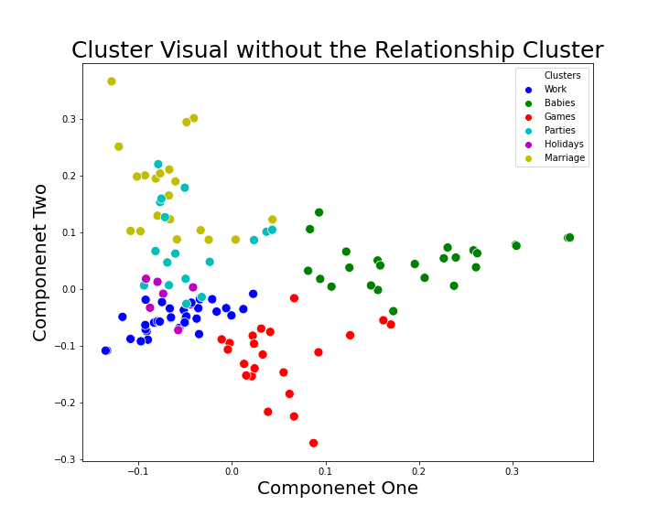
Results - Clusters

Slide 24
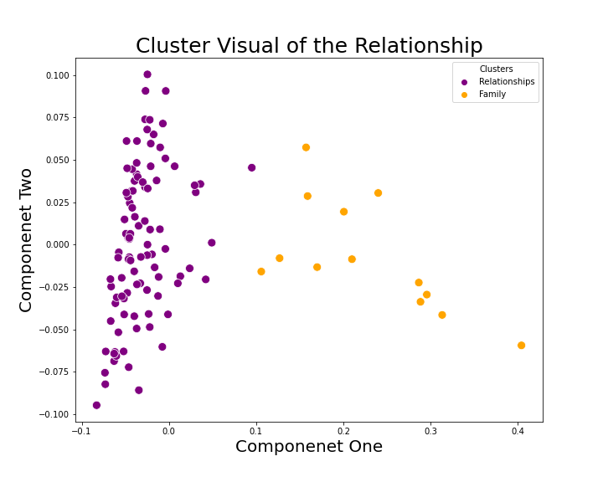
Results - Clusters

Slide 25
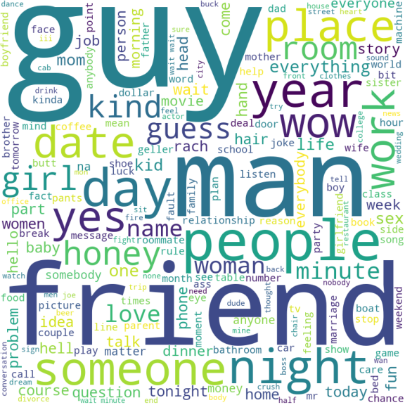
Word cloud - Relationships

Slide 26
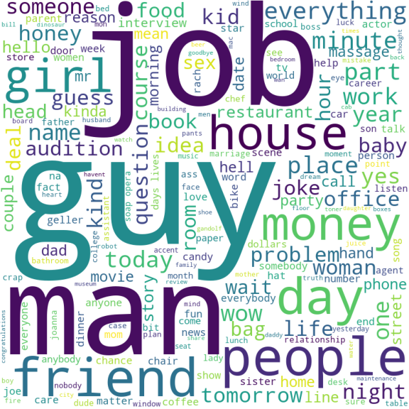
Word cloud - Work

Slide 27
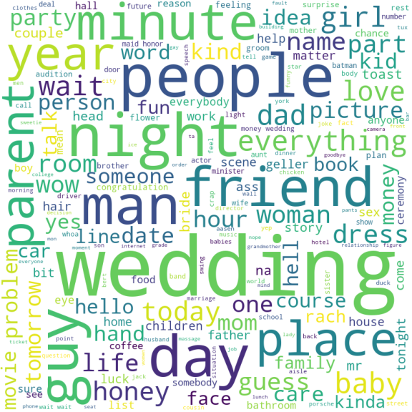
Word cloud - weddings

Slide 28
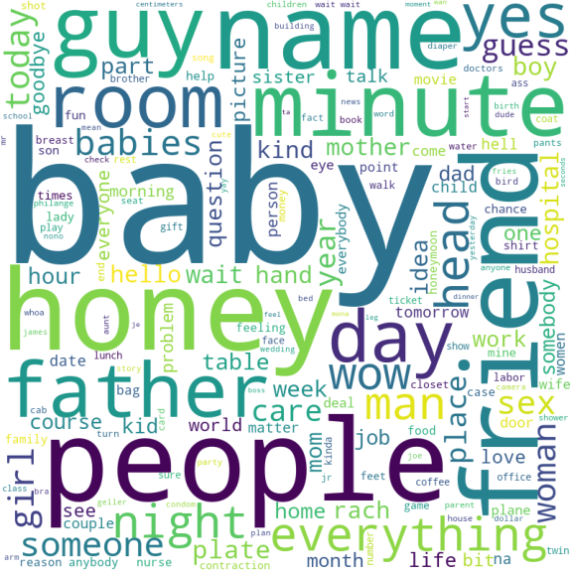
Word cloud - babies

Slide 29
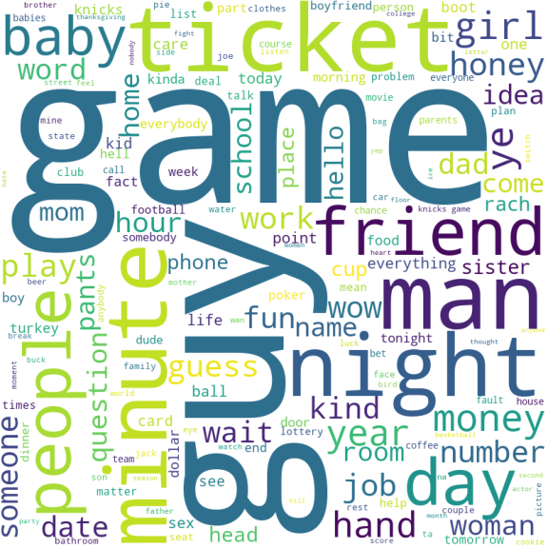
Word cloud - games

Slide 30
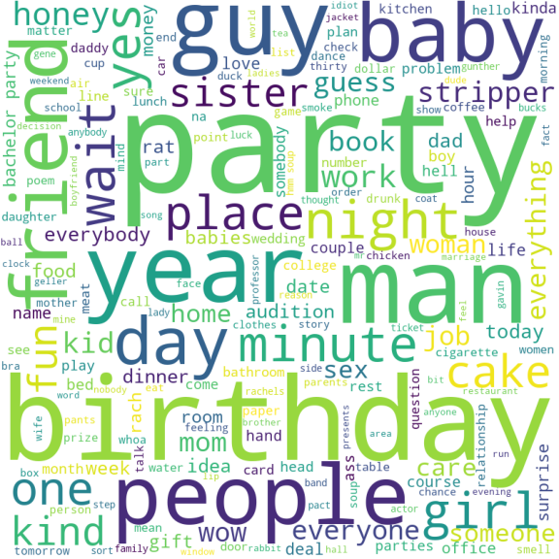
Word cloud - Parties

Slide 31
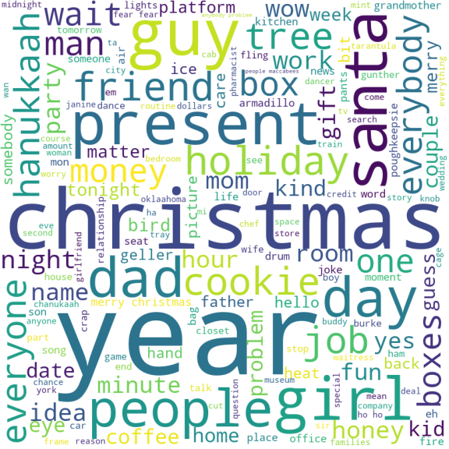
Word cloud – Holidays

